Slide 1
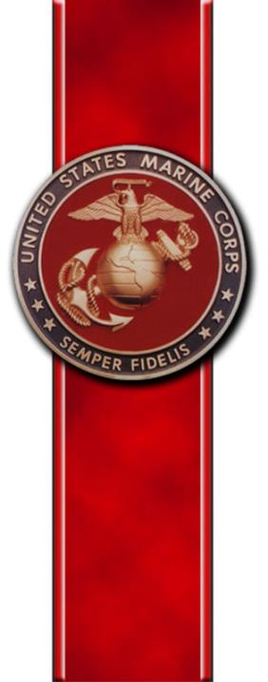

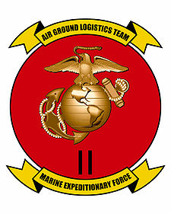

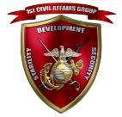
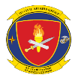
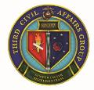

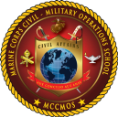
Civil Affairs
Capabilities Brief
I MEF CA Det
II MEF CA Det
III MEF CA Det
1st CAG
Camp Pendleton, CA
2D CAG
Washington DC
3D CAG
Great Lakes, IL
4th CAG
Hialeah, FL
MCCMOS (MOS Training)
Quantico, VA

Slide 2
Agenda
Purpose
Capabilities
Core Competencies
Civil-Military Operations (CMO) vs Civil Affairs (CA)
Employment
Structure

Slide 3
Purpose of USMC Civil Affairs
MCT 1.15.1 (Conduct CAO)
MCT 1.15 (Conduct CMO)
MCT 5.5 (Conduct Joint & Combined Ops)
MCT 1.14 (Conduct Stability Ops)
MCT 1.13 (Conduct Irregular Warfare)
The purpose of Marine Corps CA is to support the MAGTF Commander.
CA Marines assist the MAGTF Commander to plan, coordinate and facilitate the execution of CMO.

Slide 4
USMC CA Capabilities
Plan and Integrate CMO into MAGTF operations
Coordinate with interagency partners
Facilitate effective and efficient support of Host Nation (HN) Government
Conduct Civil Preparation of the Battlespace
  Conduct Civil Reconnaissance
  Civil Engagements
  Civil Information Analysis and advise force on the civil environment
  Manage Civil Information
Minimize civilian interference while maximizing the local population support
Notes:
4

Slide 5
USMC CA Capabilities
Stability Operations
CMO integration into MCPP (Civil Preparation of the Battlespace / Supporting Concept Development)
Civ-Mil Operations Center (CMOC)
Resource / Project / Program Management
Interorganizational Coordination
Fundamental Capabilities
Facilitation of Key Leader Engagement, Negotiation and Mediation
MCT 5.5 (Conduct Joint & Combined Operations)
PRC (Curfews, checkpoints, protection of infrastructure)
DC Operations (DC Camp operations)
MCT 1.15.1.1 (Facilitate Populace and Resources Control)
Battlefield Claims
0530 (Civil Affairs Officer Course)
Planning/Facilitating HA/DR Operations
MCT 1.13 (Conduct Irregular Warfare)
Humanitarian Civic Assistance/Theater Sec Cooperation
Validate/Nominate/Evaluate NA Projects
MCT 1.15.1.2 (Facilitate Foreign Humanitarian Assistance)
Facilitate NA Projects (QC, Metrics, Costs, Synchronization and Execution)
MCT 1.15.1 (Conduct CAO)
Collect Civil Information (ASCOPE / PMESII, Stability Assessment Framework, etc.)
CMO Planner Course
Consolidate, Analyze, Produce, Share Civil Information
MCT 1.15.1.3 (Facilitate Nation Assistance)
Identifying, validating, or evaluating Foreign Nation/Host Nation infrastructure.
MCT 1.15 (Conduct CMO)
Identifying, monitoring, and anticipating the needs of indigenous populations
MCT 1.15.1.4 (Collect Civil Information)
0531 (Civil Affairs Enlisted Course)
MCT 1.14 (Conduct Stability Ops)
MCT 1.15.1.5 (Facilitate Support to Civil Administration)

Slide 6
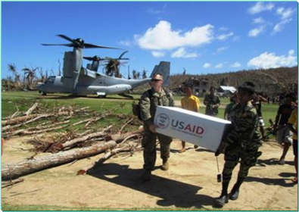
CA Core Tasks
Support to Civil Administration (SCA)
Populace and Resources Control (PRC)
Foreign Humanitarian Assistance (FHA)
Nation Assistance (NA)
Civil Information Management (CIM)

Slide 7
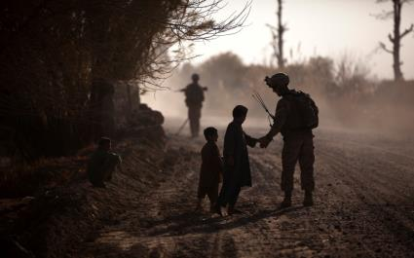
CMO and CA
CMO and (CA) are not interchangeable terms.
CMO minimize the effect a mission has on the local populace and the effect the populace has on the mission.
CA forces are organized, tasked, and trained to plan, coordinate, and facilitate the execution of CMO.
Notes:
We should begin with a quick examination of two terms: Civil-Military Operations and Civil Affairs. They are often used interchangeably when discussing CMO, even by trained Civil Affairs Soldiers and Marines, but they are not interchangeable.
CMO are the “what,” the things you do operationally. Note that they are the “activities of a commander,” not just things that CA Soldiers and Marines do. CMO is a command responsibility.
CA are the “who” of CMO. They are the forces specifically organized, tasked, and trained to conduct CMO. They are not the only ones who can do CMO – anyone can – but these are the Marines and Soldiers who do it by MOS. Keep in mind as we go through the brief, that CMO tasks in a given AO will usually far exceed to ability of the few CA Marines you will have. Your CA Marines will help you plan CMO and conduct some selected tasks, but the majority of the effort will be conducted by your own troops.

Slide 8
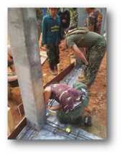
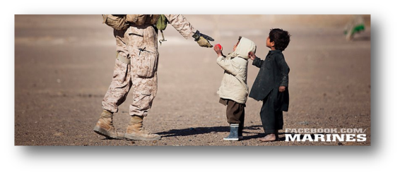
CMO vs CA
Civil-Military Operations - The activities of a commander that establish, maintain, influence, or exploit relationships between military forces and indigenous populations and institutions (IPI), by directly supporting the attainment of objectives relating to the reestablishment or maintenance of stability within a region or host nation (HN).
CMO integrate and synchronize interagency, intergovernmental organization (IGO), and nongovernmental organization (NGO) activities with joint force operations. JP 3-57 CMO Sep 2013
Civil Affairs - The purpose of Marine Corps CA is to support the MAGTF Commander.
CA Marines conduct military engagement, humanitarian and civic assistance, and nation assistance to influence HN and FN populations.
CA Marines are the subject matter experts in the planning, coordination, and execution of CMO, but the majority of the execution is conducted by the various elements of the MAGTF.
VS
Notes:
We should begin with a quick examination of two terms: Civil-Military Operations and Civil Affairs. They are often used interchangeably when discussing CMO, even by trained Civil Affairs Soldiers and Marines, but they are not interchangeable.
CMO are the “what,” the things you do operationally. Note that they are the “activities of a commander,” not just things that CA Soldiers and Marines do. CMO is a command responsibility.
CA are the “who” of CMO. They are the forces specifically organized, tasked, and trained to conduct CMO. They are not the only ones who can do CMO – anyone can – but these are the Marines and Soldiers who do it by MOS. Keep in mind as we go through the brief, that CMO tasks in a given AO will usually far exceed to ability of the few CA Marines you will have. Your CA Marines will help you plan CMO and conduct some selected tasks, but the majority of the effort will be conducted by your own troops.

Slide 9
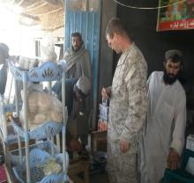
CMO and the MAGTF
CMO supports the MAGTF by:
  Providing expertise on the civil component in order to gain / maintain civil situational awareness
  Enhancing legitimacy of the MAGTF in the eyes of the civilian population IOT isolate the enemy from them
  Leverage relationships with civilian partners: locals, IPI, interagency, IGOs, NGOs, etc.
  Minimize civilian interference and maximize support
Notes:
Among the principal ways that Marine Corps CA supports the MAGTF is by conducting liaison operations. They do this with:
All Levels of U.S. Military Command Structure up to COCOM
Host Nation, Coalition / Allied Military Forces
Foreign Governments
Intergovernmental Organizations (IGOs)
Other U.S. Government Agencies (OGA)
Non-governmental Organizations (NGOs)
In simpler terms, the wartime mission of CA forces is to assist the commander in keeping the civilians out of the way on the battlefield and to help gain the support of the civilian populace to reduce interference with the military.
In peacetime, Marine Corps CA forces engage in humanitarian and relief operations as well conduct various surveys and assessments for non-US militaries and governments.
Caption 1: An Army CA specialist takes a closer look at a local resident’s retina in Kophisophi, Afghanistan, during a Humanitarian / Medical Assistance mission on July 20, 2002.
Caption 2: A Marine CA specialist conduct daily meeting with tribal elders in Al Anbar province in 2006.

Slide 10
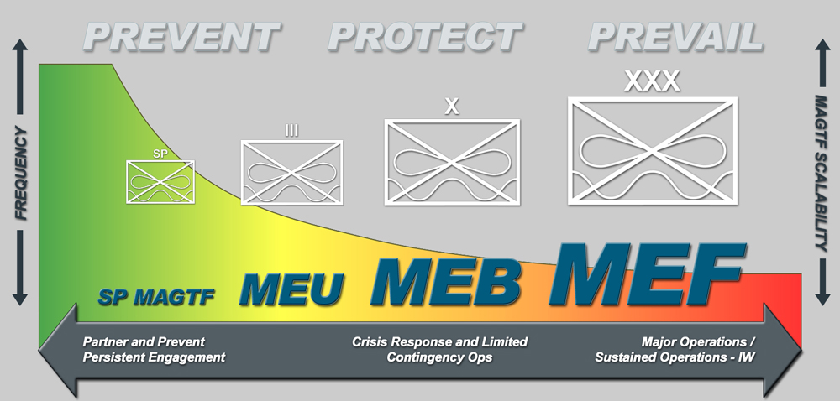
Concept of Marine CA
Employment
1 x CA Team
1 x CA Det
1 x CA Det + 1 x CAG
Marine Expeditionary Unit (MEU) or Battalion
  - CA Team = 7 Marines AC or 5 Marines RC
Marine Expeditionary Brigade (MEB) or Regimental Combat Team (RCT)
  Det = 51 Marines AC or 25 Marines RC
Marine Expeditionary Force (MEF)
  MEF has one organic CA Detachment (51 Marines) for deployment.
  MEF is supported by one RC CAG (180 Marines)
Notes:
MARINE EXPEDITIONARY FORCE (MEF)
The MEF is our Corps’ principal warfighting organization during larger crises or contingencies. Normally commanded by a Lieutenant General, a MEF can range in size from one division and aircraft wing to multiple divisions and aircraft wings, together with one or more logistics groups.
MARINE EXPEDITIONARY BRIGADE (MEB)
The MEB, normally commanded by a Brigadier General, is a scalable MAGTF that ranges from a General Officer-led staff up to a force of 20,000 Marines. The scalable MEB is capable of full spectrum operations, and self-sustainment for 30 days.
MARINE EXPEDITIONARY UNIT (MEU)
The MEU is MAGTF of about 2,000 Marines commanded by a colonel and is able to deploy with 15 days of accompanying supplies.
SPECIAL PURPOSE MAGTF (SPMAGTF)
A SPMAGTF is task organized to accomplish a specific mission, operation, or regionally focused exercise. They can be organized, trained, and equipped with Marine forces to conduct a wide variety of expeditionary operations ranging from peacetime missions, to training exercises, and responses to contingencies and crises.
Marine Corps CA is designed to support operational, or tactical-level MAGTF’s throughout each phase of a large-scale contingency or major theater war. Supporting unit type may vary whether Active Component (AC) or Reserve Component (RC).
Marine Expeditionary Unit (MEU) or Battalion = 1 x CA Team
- Team = 7 Marines AC, 5 Marines RC
Marine Expeditionary Brigade (MEB) or RCT = 1 x CA Detachment (Det)
Det = 51 Marines AC, 25 Marines RC
CA Det provides 1 x CA Team per battalion-sized MSE, CA Det HQ augmenting the GCE RCT S-3 CMO staff element and MEB G-9 CMO staff element.
Marine Expeditionary Force (MEF) = 1 x CA Det (AC) and 1 x Civil Affairs Group (CAG) (RC)
MEF has one organic CA Detachment for deployment.
MEF is supported by one CAG (180 Marines), providing 1 x CA Det per RCT and other MSC’s (as required), and CA augments to MEF G-9 CMO element.

Slide 11
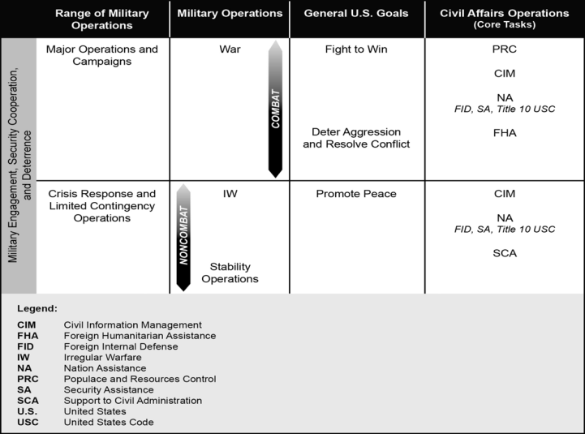
CA Core Tasks in the
Range of Military Operations

Slide 12
Concept of CA Employment
Phases 0 - I
Phase V
Enable
Civil
Authority
Phase 0
Shaping
(Peacetime)
Phase I
Deter
Phase II
Seize the
Initiative
Phase III
Dominate
Phase IV
Stabilize
More
CMO
Back to Phase 0
Shaping
Amount of CMO
Performed
and CA Forces
Required
Population and
Resource Control
Support to Civil Administration
Humanitarian
Assistance
Nation Assistance
Less
CMO
Civil Information Management
TSC and HA/DR
In Phases 0-1, CA forces support Combatant Command and MAGTF Theater Support Cooperation objectives, as well as react to Humanitarian Assistance/Disaster Relief situations as required.

Slide 13
Concept of CA Employment
Phases II - III
Phase V
Enable
Civil
Authority
Phase 0
Shaping
(Peacetime)
Phase I
Deter
Phase II
Seize the
Initiative
Phase III
Dominate
Phase IV
Stabilize
More
CMO
Back to Phase 0
Shaping
Amount of CMO
Performed
and CA Forces
Required
Population and
Resource Control
Support to Civil Administration
Humanitarian
Assistance
Nation Assistance
Less
CMO
Civil Information Management
It is vital that CA leadership and elements be involved in operations during these two phases, instead of as an afterthought. During clearing operations, CA forces assess needs for immediate action or follow-on CMO, depending on severity. The ability to quickly mitigate the effects of combat operations on the populace is essential to denying enemy forces the non-kinetic initiative.

Slide 14
Concept of CA Employment
Phases IV - V
Phase V
Enable
Civil
Authority
Phase 0
Shaping
(Peacetime)
Phase I
Deter
Phase II
Seize the
Initiative
Phase III
Dominate
Phase IV
Stabilize
More
CMO
Back to Phase 0
Shaping
Amount of CMO
Performed
and CA Forces
Required
Population and
Resource Control
Support to Civil Administration
Governance and Development LOOs
Humanitarian
Assistance
Nation Assistance
Less
CMO
Civil Information Management
Most are familiar with CA involvement in Phases IV – V due to CA employment in the latter stages of OIF and OEF. Typically, CA forces are responsible to the Battle Space Owner for the Governance and Development Lines Of Operations – in the absence of other Subject Matter Experts. The ability to achieve significant gains in these phases depends on involvement of CA forces during the previous phases. Late involvement of CA personnel and/or poor employment leads to diminished returns.

Slide 15
USMC Total CA Structure
Active Component
Reserve Component
I MEF
  2 LtCol 0530
  1 GySgt 0531
2d MEB II MEF
  1 Maj 0530
  1 Capt 0530
III MEF
  1 LtCol 0530
  1 GySgt 0531
5th MEB CENTCOM
  1 LtCol 0530
  1 Maj 0530
  1 SSgt 0531
FHG
  1 Capt 0530
MCCMOS IMA Det
7-8006
9-0532
I MEF CA Det
8 Maj–Capt 0530
43 Cpl-GySgt 0531
II MEF CA Det*
8 Maj-Capt 0530
43 Cpl-GySgt 0531
III MEF CA Det
8 Maj-Capt 0530
43 Cpl-GySgt 0531
1st CAG
48-(0530)
58-(0531)
PPO
1 Maj 0530
AFRICOM
1 Maj 0530
11th MEU
1 GySgt 0531
22nd MEU
1 GySgt 0531
31st MEU
1 GySgt 0531
MCSCG
CMO Officers
2 Maj 8006
MCIOC
1 1stLt 0530
2nd CAG
48-(0530)
58-(0531)
13th MEU
1 GySgt 0531
24th MEU
1 GySgt 0531
3d Marines
1 Maj 0530
1 GySgt 0531
MARFORCOM
  1 Maj 0530
  1 Maj 8006
  2 GySgt 0531
MCTOG
4 Sgt -GySgt 0531
3rd CAG
48-(0530)
58-(0531)
15th MEU
1 GySgt 0531
26th MEU
1 GySgt 0531
4th Marines
1 Maj 0530
1 GySgt 0531
4th CAG
48-(0530)
58-(0531)
USSOCOM
1 Maj 8006
1 GySgt 0531
1st Marines
1 Maj 0530
1 GySgt 0531
2d Marines
1 Maj 0530
1 GySgt 0531
6th Marines
1 Maj 0530
1 GySgt 0531
CD&I/MCCDC
-Advocate
(delegated to SWCIWID)
JOINT STAFF
1 LtCol 0530
MARFORAF
1 Maj 0530
5th Marines
1 Maj 0530
1 GySgt 0531
MARFORSOUTH
1 Maj 0530
7th Marines
1 Maj 0530
1 GySgt 0531
8th Marines
1 Maj 0530
1 GySgt 0531
MCCMOS
-Doctrinal Proponent
-MOS School
MARFORSOC
1 Maj 8006
199 TOTAL AC CA BILLETS
459 TOTAL RC CA BILLETS
*II MEF CA Det has ASR of zero for officers
Notes:
AC:
45 AC 0530 BILLETS
149 AC 0531 BILLETS
194 TOTAL AC CA BILLETS
***Majority of billets at the Regt’s and MEUs are filled with untrained Marines.
OPFOR:
Active Duty CA detachments belong to the MEF Headquarters Group (MHG)
Currently II MEF CA Det has ASRs of zero for officers
MARFORCOM HQTRS: CA OpsO—Maj; CA Chief—GySgt; CA SNCO—SSgt
MEF CE T/O: G3 CMO Planners: (1) LtCol and (1) GySgt; CA Liaison Officer: (1) Major
5th MEB: CMO/EMBASSY LNO—LTCOL (0530); ASSISTANT CMO OFFICER—MAJ (0530); CMO CHIEF—SSGT (0531)
Regimental S-3s: 1 Maj (0530) and 1 GySgt (0531)
MEU S3s: 1 GySgt (0531)
Supporting Establishment:
MCTOG CA Instructors: 1 GySgt, 2 SSgt, 1 Sgt
RC:
201 RC 0530 BILLETS
4 RC 0531 BILLETS
241 RC 0532 BILLETS
18 CA/CMO 8006 BILLETS (5 AC, 13 RC)
--FHG CE: CA Plans Officer-- Capt 0530
--All CAGs have I&I Staff: LtCol—0530
--Note: Each Detachment HQ has a Displaced Persons / Refugee Team, an International Law / Claims Team,
a Civil Liaison Officer, CIM Officer, Rule of Law Officer, and an Economic Development Officer
--Reserve CAGs belong to the Force Headquarters Group (FHG)
By comparison, IO community only has 109 billets in the AC:
MISO NCO 0521 - 77
IO Specialist 0551 - 2
Basic IO Officer 0510 - 11
MISO Officer 0520 - 8
Advanced IO Planner 0550 - 11

Slide 16
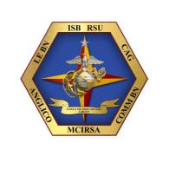
Civil Affairs Groups (RC)
III
HQ & Staff Elements
9/45/0/0
179
G9 Branch
12/9/1/1
Public Health Section
0/0/1/1
I
I
I
I
CA DET
4/5/1/0
CA DET
4/5/1/0
CA DET
4/5/1/0
CA DET
4/5/1/0
CA Team
2/3/0/0
CA Team
2/3/0/0
CA Team
2/3/0/0
CA Team
2/3/0/0
CA Team
2/3/0/0
CA Team
2/3/0/0
CA Team
2/3/0/0
CA Team
2/3/0/0
CA Team
2/3/0/0
CA Team
2/3/0/0
CA Team
2/3/0/0
CA Team
2/3/0/0
Note: Each Detachment HQ has a Displaced Persons / Refugee Team, an International Law / Claims Team,
a Civil Liaison Officer, CIM Officer, Rule of Law Officer, and an Economic Development Officer
Reserve CAGs belong to the Force Headquarters Group (FHG)
16
TO&E 24 AUG 2015
Notes:
All CAGs have I&I Staff: LtCol—0530

Slide 17
CA Detachment (AC)
MEF
DET HQ
2- MO
7- ME
CAT 1
1 –MO
6 – ME
CAT 2
1 –MO
6 – ME
CAT 3
1 –MO
6 – ME
CAT 4
1 –MO
6 – ME
CAT 5
1 –MO
6 – ME
CAT 6
1 –MO
6 – ME
G3 - FECC
51
Active Component CA detachments belong to the MEF Headquarters Group (MHG)
Currently II MEF CA Det has ASRs of zero for officers

Slide 18
Additional CA Billets
III MEF
2/1/0/0
G3 CMO Planners: (1) LtCol and (1) GySgt Liaison Group: (1) LtCol and (1) GySgt CA Liaison Officer: (1) Major
II MEF
2/1/0/0
I MEF
2/1/0/0
1st MAR
1/1/0/0
4th MAR
1/1/0/0
7th MAR
1/1/0/0
2nd MAR
1/1/0/0
5th MAR
1/1/0/0
8th MAR
1/1/0/0
1 Maj and 1 GySgt in Regt S-3
3rd MAR
1/1/0/0
6th MAR
1/1/0/0
22th MEU
0/1/0/0
11th MEU
0/1/0/0
31st MEU
0/1/0/0
24th MEU
0/1/0/0
13th MEU
0/1/0/0
1 GySgt per MEU in S3
26th MEU
0/1/0/0
15th MEU
0/1/0/0
MCTOG
0/4/0/0
MARFORAFRICOM
1/0/0/0
1 GySgt, 2 SSgt, 1 Sgt CA Instructors at MCTOG
MARFORSOUTHCOM
1/0/0/0
Majority of billets at the Regt’s and MEUs are filled with untrained Marines.
Notes:
I MEF CE TO&E: Aug 24, 2015
BIC: M2014600411 (CA Liaison Off.--Major)
M2014601211 (CA Off.—LtCol)
M2014601212 (CA SNCO—GySgt)

Slide 19
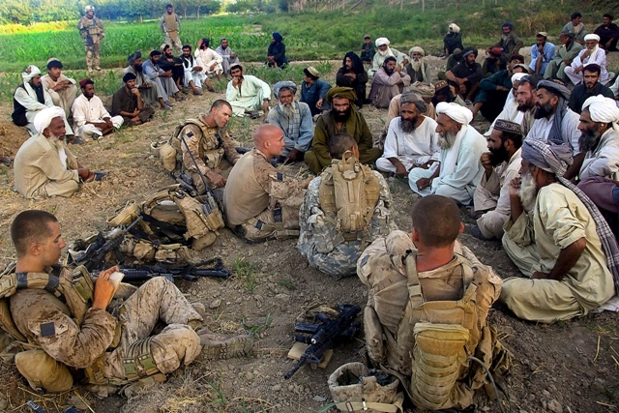
Questions?
Notes:
In memory of Sgt William Cahir (pronounced “care”) 40, was a former newspaper correspondent for Newhouse Newspapers; a Congressional committee staffer for U.S. Senator Ted Kennedy (D-Mass.); and a 2008 Democratic candidate for U.S. Congress in Pennsylvania's 5th District, when he was killed by a single enemy gunshot August 13, 2009 while on active duty in Afghanistan as a U.S. Marine Reservist.
William John Cahir was a sergeant in the Marine Corps Reserve's then 4th Civil Affairs Group, headquartered in Washington, D.C.
Sgt Cahir was killed during Eastern Resolve II, a pre-dawn offensive operation in Helmand Province's Now Zad district. Much of the August 12, 2009 operation focused on controlling the Taliban-held town of Dananeh. Once a city of 30,000, more than three years of fighting had previously reduced the town’s population to an estimated 2,000. Eastern Resolve II involved approximately 400 U.S. Marines and 100 Afghan troops, and was intended to cut militant trade and supply lines, and to allow local residents to vote in the August 20 Afghan presidential election, 2009.
Pictured above is Sgt Cahir, left of the Company Commander who does not have his body armor on.

Slide 20
BACKUPS

Slide 21
Summary
This brief provided an overview of U.S. Marine Corps Civil Affairs and Civil-Military Operations.
Review:
  Civil-Military Operations are a command responsibility
  CMO minimize civilian impact to operations and a mission’s impact on the civilian populace
  Civil Affairs forces are organized, trained, and equipped to plan, coordinate, and facilitate the execution of CMO.
  CA Marines integrate civil considerations into planning.

Slide 22
Definitions
Civil-Military Operations (CMO): Civil-military operations (CMO) are the activities of a commander performed by designated civil affairs or other military forces that establish, maintain, influence, or exploit relationships between military forces and indigenous populations and institutions, by directly supporting the attainment of objectives relating to the reestablishment or maintenance of stability within a region or host nation (HN)... (JP 3-57)
  Note: Although CMO may be performed by designated civil affairs Marines or other military forces, the ultimate conduct of CMO are the responsibility of a commander. (MCWP 3-33.1)
Civil Affairs (CA): Designated Active and Reserve Component forces and units organized, trained, and equipped specifically to conduct civil affairs operations and to support civil-military operations. CA forces conduct military engagement, humanitarian and civic assistance, and nation assistance to influence HN and FN populations. CA forces assess impacts of the population and culture on military operations; assess impact of military operations on the population and culture; and facilitate interorganizational coordination. (JP 3-57)
  Note: Since this term applies to people, it is incorrect to say that one would conduct “CA.” Marines conduct CMO, not CA. (MCWP 3-33.1)
Civil Affairs Operations (CAO): Actions planned, executed, and assessed by civil affairs forces that enhance awareness of and manage the interaction with the civil component of the operational environment; identify and mitigate underlying causes of instability within civil society; or involve the application of functional specialty skills normally the responsibility of civil government. (JP 3-57)
  Note: The majority of civil affairs Marines are “generalists”. While we conduct limited CAO, we are manned, trained and equipped for two of the six functional specialist skills within our structure (Public Health and Welfare and Rule of Law). All six of the functional specialty skills resides in US Army Reserve CA forces.

Slide 23
CMO Related MAGTF Tasks
MCT 1.14 Conduct Stability Operations
MCT 1.14.1 Establish Civil Security
MCT 1.14.2 Establish Civil Control
MCT 1.14.3 Essential Services
MCT 1.14.4 Support to Governance
MCT 1.15 Conduct Civil-Military Operations
MCT 1.15.1 Conduct Civil Affairs Operations
MCT 1.15.1.1 Facilitate Populace and ResourceS Control
MCT 1.15.1.2 Facilitate Foreign Humanitarian Assistance
MCT 1.15.1.3 Facilitate Nation Assistance
MCT 1.15.1.4 COLLECT Civil Information
MCT 1.15.1.5 Facilitate Support to Civil Administration
MCT 1.15.2 Plan and Direct Civil-Military Operations
MCT 1.15.3 Support Economic & Infrastructure Development
Notes:
The Activities of the Marine Corps CA Force are governed by the Marine Corps Task (MCT) list. The two primary tasks are Conduct CMO and Conduct CAO. These are further supported by 5 subtasks, which match the Army’s 5 CA core tasks as described in the previous slide, ensuring that both services are in harmony when they conduct joint CAO and CMO, especially in view of the fact that the US Army Special Operations Command has doctrinal proponency for Civil Affairs. This is essential, as both Army and Marine Corps forces operate in concert with one another. For example, in Al Anbar Province in Iraq, Army CA units frequently support Marine Corps RCTs, while Marine Corps CA units frequently support the Army BCT in Ar Ramadi.

Slide 24
CMO Planning Considerations
CMO are an inherent command responsibility, ensure the commander considers the civil dimension during planning
CMO performed Phase 0 (shape) thru Phase 5 (transition)
CMO should be coordinated with all civilians in the area
All elements of the MAGTF perform CMO
Integrated with the rest of the MAGTF staff

Slide 25
CMO Tactical Level Tasks
CE
  Met with local government officials (Key Leader Engagement)
  Assist in elections preparations
  Facilitate economic development
  Support local governance
  Plan and Integrate CMO with IO campaign
  Coordinate with interorganizational partners
LCE
  Assist HN government with logistical support
  Provide health services
  Infrastructure repairs
  Establish DC Camps
  Provide drinking water
  Evacuate disaster victims
  Distribute HDRs
GCE
  Vehicle check point
  Establish CMOC
  Security at polling sites
  Populace & Resources control
  Badging, Berming, Biometrics
  Key Leader Engagement
  NGO convoy security
ACE
  Transport Key Leaders
  NEO
  Aerial-delivery of medical supplies
  Escort an NGO convoy
  Aerial observation of crops and farmland
  Aeromedical evacuations
Notes:
The Activities of the Marine Corps CA Force are governed by the Marine Corps Task (MCT) list. The two primary tasks are Conduct CMO and Conduct CAO. These are further supported by 5 subtasks, which match the Army’s 5 CA core tasks as described in the previous slide, ensuring that both services are in harmony when they conduct joint CAO and CMO, especially in view of the fact that the US Army Special Operations Command has doctrinal proponency for Civil Affairs. This is essential, as both Army and Marine Corps forces operate in concert with one another. For example, in Al Anbar Province in Iraq, Army CA units frequently support Marine Corps RCTs, while Marine Corps CA units frequently support the Army BCT in Ar Ramadi.

Slide 26

CA Organizations
Great Lakes
Washington DC
3D CAG
Quantico
1st CAG
Camp Pendleton
2D CAG
Camp
Lejeune
III MEF Det
I MEF Det
II MEF Det
Hialeah
4th CAG
MCCMOS
Okinawa
26
Notes:
Reserve Civil Affairs Forces are organized into four Civil Affairs Groups.
1st CAG is located at Camp Pendleton, California,
2nd CAG at Anacostia, Washington D.C.
3rd CAG at Great Lakes Naval Station, Illinois
4th CAG at Hialeah, Florida.
Each CAG has 179 Marines/Sailors distributed through a HQ element, a G-9 staff and four CA detachments.
Each Detachment is composed of four CA Teams.
Active duty CA Forces are organized into detachments assigned to each MEF Headquarters Group.
Each Det. has 51 Marines assigned to the Det. HQ or one of six seven man teams.
CAGs are aligned to support the MEFs with
1st CAG supporting I MEF
2nd CAG supporting II MEF
3rd CAG supporting III MEF
4th CAG is in general support
Other active duty CA billets are found in the MEF G-3 FOPs and in the S-3 sections of the Regiments and the MEUs.
All Civil Affairs Marines are trained at the Marine Corps Civil Military Operations School (MCCMOS) at Quantico, VA.
The Basic MOS course is four weeks of intensive academic training with a majority time spent in practical application and performance evaluation.
CMO planners must attend a two week CMO Planner Course.
Members of the G-9 staff attend a one week G-9 course.

Slide 27
Concept of CA Employment
Marine Corps CA is designed to support operational, or tactical-level MAGTF’s throughout each phase of a large-scale contingency or major theater war.
MEU or Battalion = Civil Affairs Team (Active Component (AC) or Reserve Component (RC)
  - The MEU or battalion is supported by one CA Team.
MEB or RCT = CA Detachment (AC or RC)
  - The MEB or RCT is supported by one CA detachment, with one CA Team per battalion-sized major subordinate element and a CA detachment HQ augmenting the GCE RCT S-3 CMO staff element and MEB G-9 COM staff element.
MEF = CA Detachment (AC) and Civil Affairs Group (RC)
  Organic to the MEF is one CA Detachment for deployment as required.
  The MEF is supported by one CAG, with one CA detachment per RCT and other MSC’s (as required), with CA augments to MEF G-9 CMO element.

